Slide 1

FBI
MAINSTEET(INTERNET)
Senior Systems Engineer
Internet Payments

Slide 2
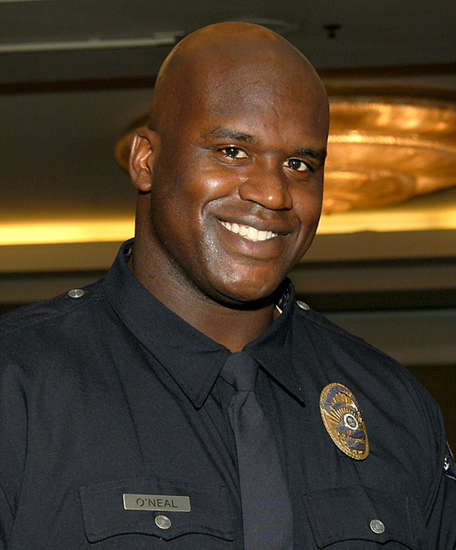

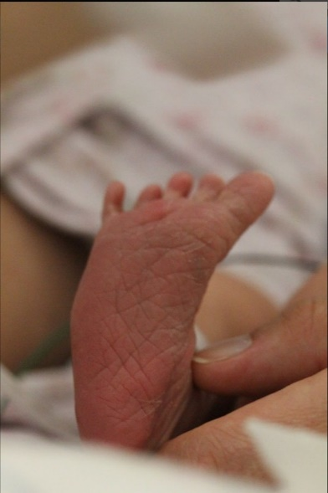


FBI
DEFENSE(Middelfield)
KIDNAPPING
bit.ly/1D8723
Senior Systems Engineer
bit.ly/1D8723
bit.ly/1D8723

Slide 3

FBI
DEFENSE(Middelfield)
KIDNAPPING
bit.ly/1D8723
Senior
Systems
Engineer
bit.ly/1D8723
bit.ly/1D8723

Slide 4

FBI
DEFENSE(Middelfield)
KIDNAPPING
bit.ly/1D8723
Senior
Systems
Engineer
bit.ly/1D8723
bit.ly/1D8723

Slide 5


FBI
DEFENSE(Middelfield)
KIDNAPPING
HOMICIDE(LOIGCAL)
bit.ly/1D8723
Senior
Systems
Engineer
bit.ly/1D8723
bit.ly/1D8723

Slide 6
FBI
DEFENSE(Middelfield)
KIDNAPPING
HOMICIDE(LOIGCAL)
bit.ly/1D8723
Senior
Systems
Engineer
bit.ly/1D8723
bit.ly/1D8723

Slide 7

FBI
DEFENSE(Middelfield)
KIDNAPPING
HOMICIDE(LOGICAL)
bit.ly/1D8723
Senior
Systems
Engineer
bit.ly/1D8723
bit.ly/1D8723

Slide 8


FBI
§187 23
DEFENSE(Middelfield)
§187
KIDNAPPING
HOMICIDE(LOGICAL)
CHILD ABUSE
§PREA
bit.ly/1D8723
Senior
Systems
Engineer
bit.ly/1D8723
bit.ly/1D8723

Slide 9



FBI
DEFENSE(Middelfield)
§187
§PREA
bit.ly/1D8723
Senior
Systems
Engineer
bit.ly/1D8723
bit.ly/1D8723

Slide 10


FBI
DEFENSE(Middelfield)
§187
§PREA
bit.ly/1D8723
Senior
Systems
Engineer
Manager,
Dallas
bit.ly/1D8723
bit.ly/1D8723

Slide 11
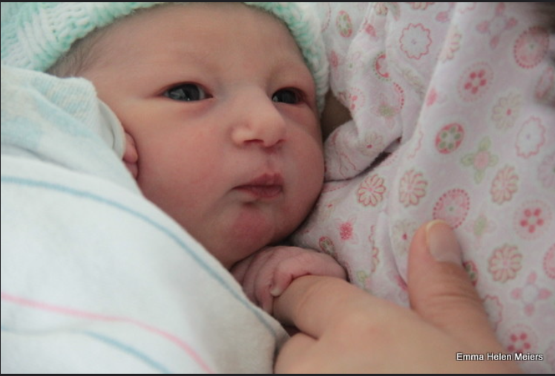

FBI
DEFENSE(Middelfield)
§187
§PREA
bit.ly/1D8723
Senior
Systems
Engineer
Manager,
Dallas
bit.ly/1D8723
bit.ly/1D8723

Slide 12


FBI
DEFENSE(Middelfield)
§187
§PREA
bit.ly/1D8723
Senior
Systems
Engineer
Manager,
Dallas
bit.ly/1D8723
bit.ly/1D8723

Slide 13

FBI
DEFENSE(Middelfield)
§187
§PREA
bit.ly/1D8723
Senior
Systems
Engineer
Manager,
Dallas
bit.ly/1D8723
bit.ly/1D8723

Slide 14
FBI
DEFENSE(Middelfield)
§187
§PREA
bit.ly/1D8723
Senior
Systems
Engineer
Manager,
Dallas
bit.ly/1D8723
bit.ly/1D8723

Slide 15


Gorbachev

Slide 16
Gorbachev

Slide 17
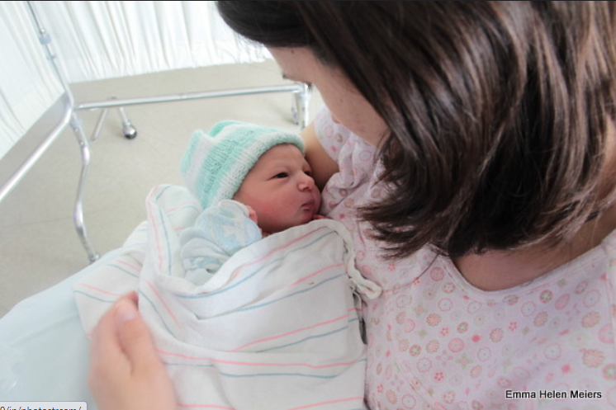

Slide 18

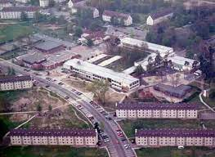

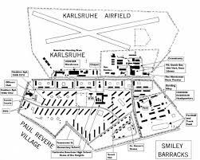
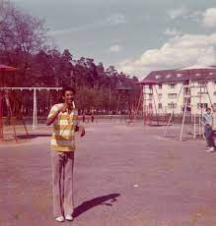
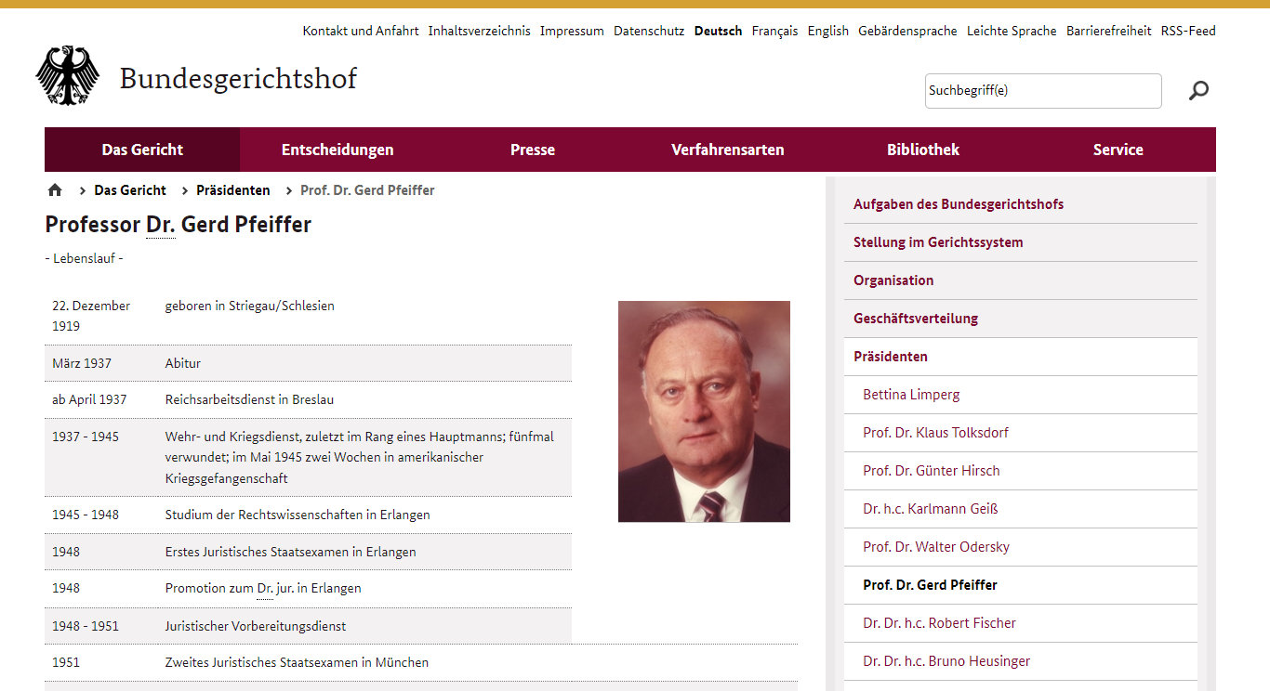

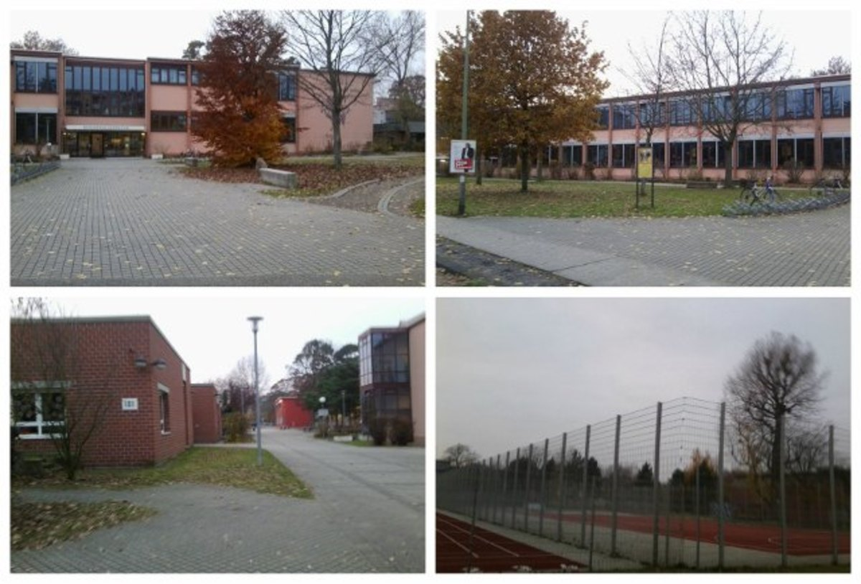
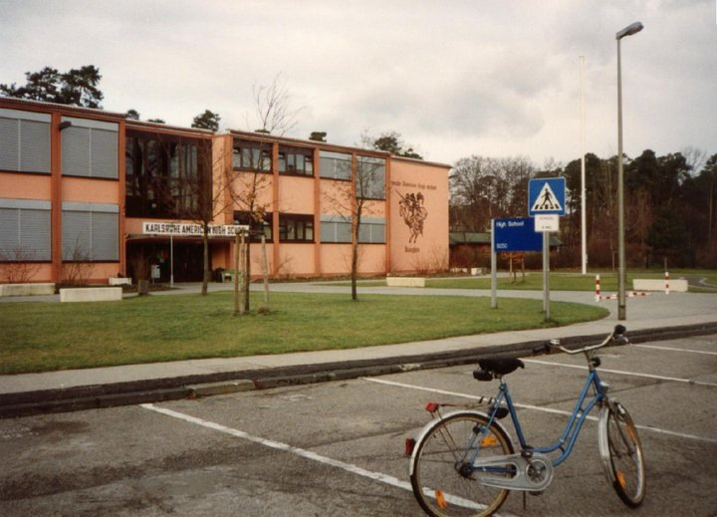

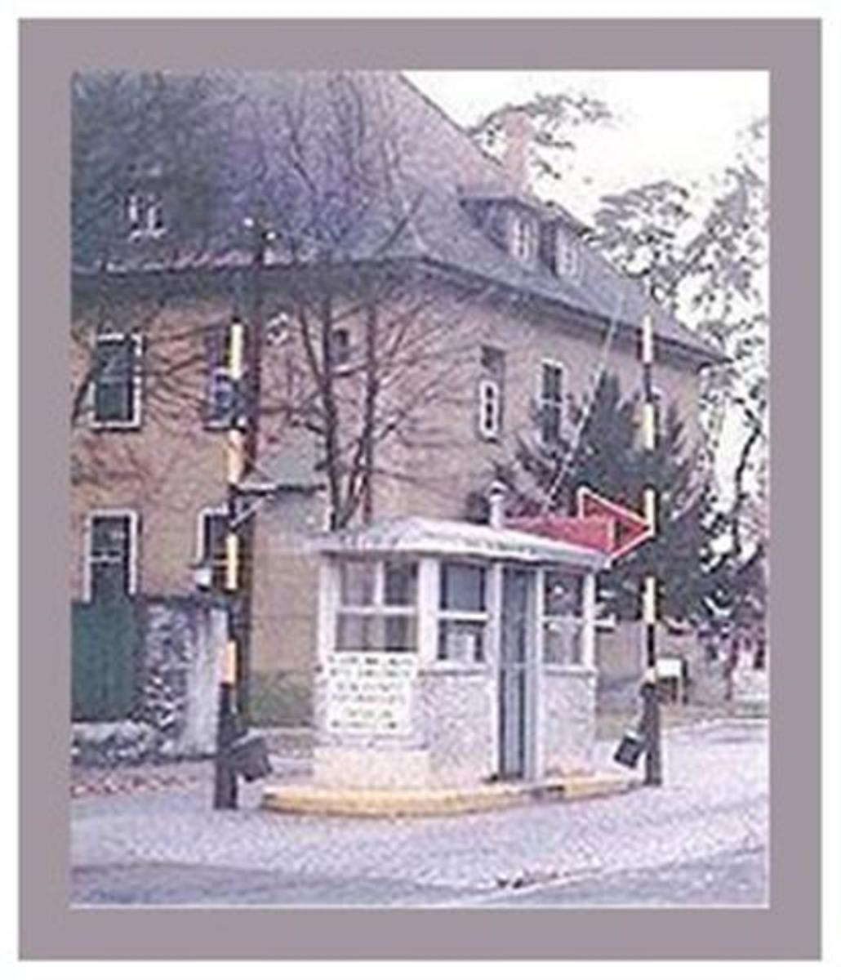
nonPoliceXavier
zwei Wochen in amerikanischer Kriegsgefangenschaft

Slide 19
FBI
DEFENSE(Middelfield)
§187
§PREA
bit.ly/1D8723
Senior
Systems
Engineer
Manager,
Dallas
bit.ly/1D8723
bit.ly/1D8723

Slide 20

FBI
MAINSTREET(DISNEY)
HOMCIDE
CHILD ABUSE
KIDNAPPING
ATOM BOMB
Senior Systems Engineer
Internet Payments

